Slide 1
MUSIC-STREAMING APP DATABASE
INFO 6210 – FINAL PROJECT
GROUP B
WENQING LIANG, AMEYA PATANKAR, NIRAV PATEL, SMEET PATEL

Slide 2
DESCRIPTION
Music-streaming applications (e.g. Spotify, iTunes, Apple Music).
Users of the application will be able to perform music-related searches, listen to songs online live, and add them to their personal playlists and favorite lists.
The database maintains information related to Music and Users.

Slide 3
OBJECTIVES
Persist information related to Music, such as Artists, Albums, Genres, Songs, and Lyrics.
Manage user information and preferences, such as Playlists, Favorites, Purchased, and Downloads.

Slide 4
BUSINESS RULES
Purchases are the songs purchased by each user account. Once a song is purchased, it will be available for the same user account forever across all devices after logging in, i.e. users do not need to purchase the exact same song twice.
Playlists are lists of songs. All playlists are private, i.e. there is no publicly shared playlists across different users.
Favorites is a list which contains all songs that users have marked “heart” with. There is only one such list for each user account.
Songs can be purchased, added to playlists, and added to favorite.

Slide 5
ENTITIES: 14
Artist
Album
Genre
Songs
Lyrics
Users
Playlists
Favorites
Purchases
Artist_Album
Album_Genre
Artist_Genre
Songs_Album
Songs_Playlist

Slide 6
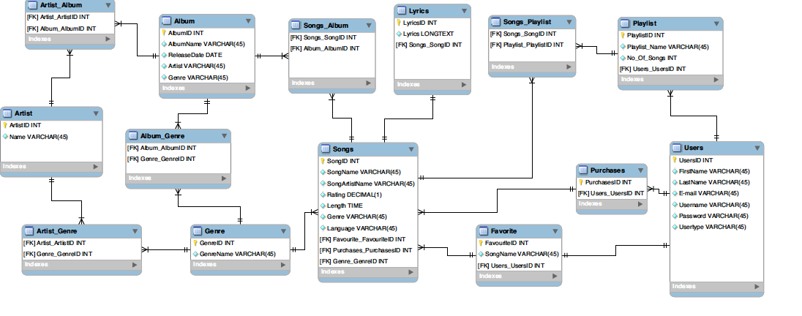
ERD

Slide 7
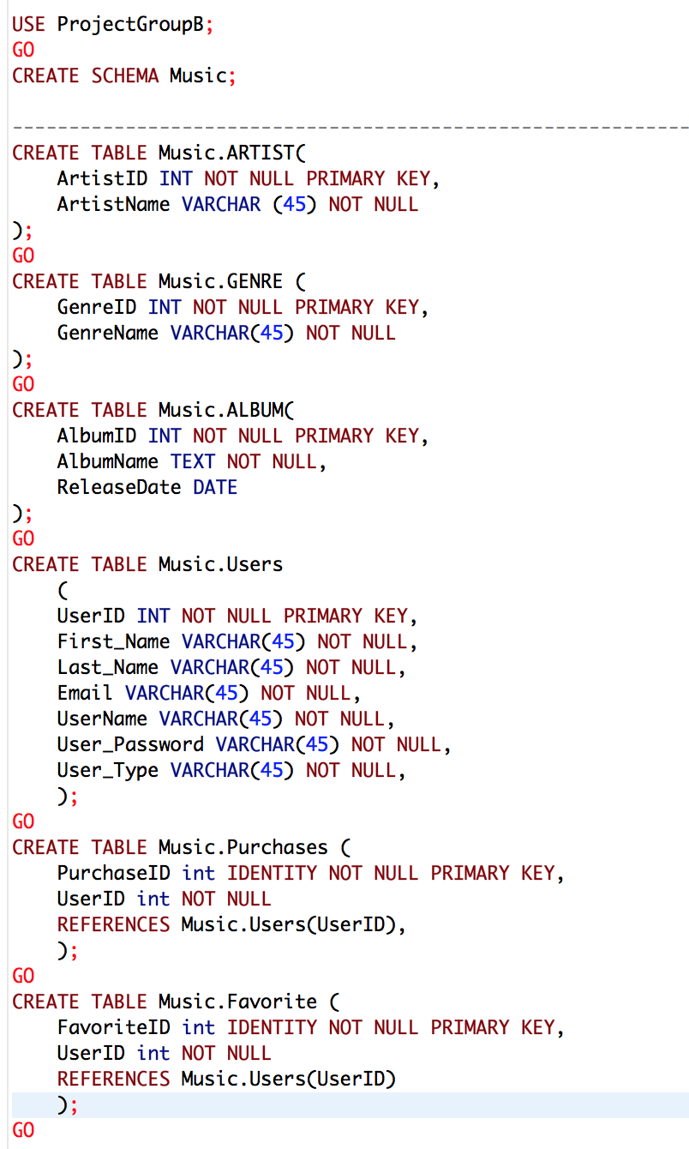
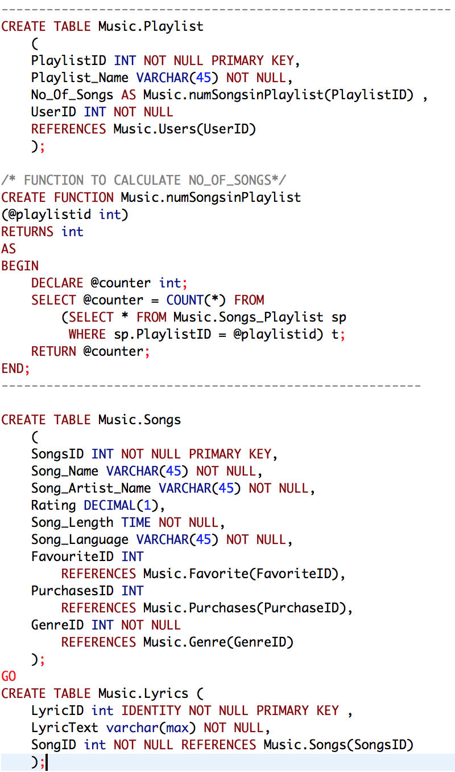
SQL DDL

Slide 8
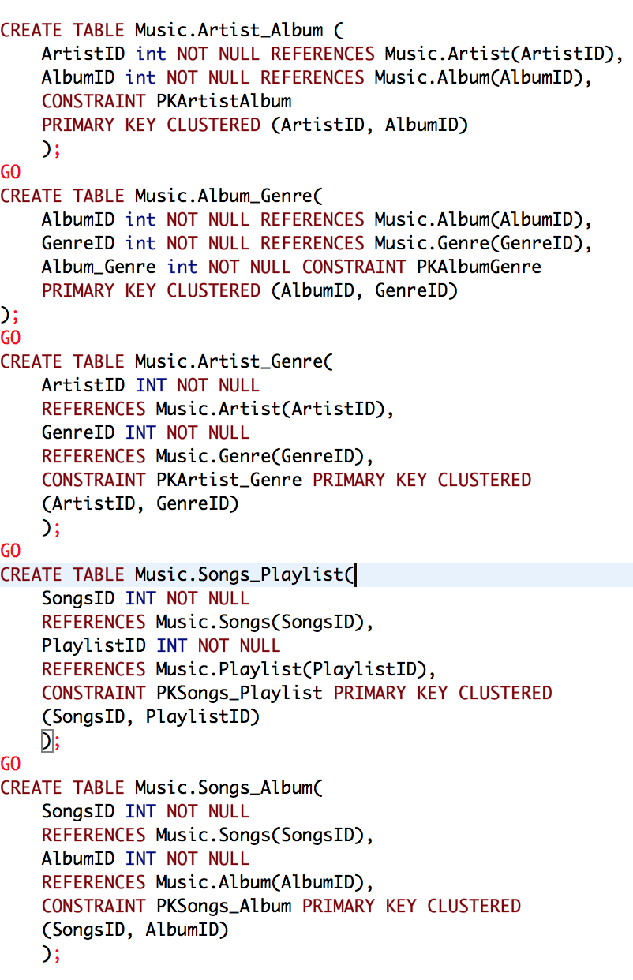
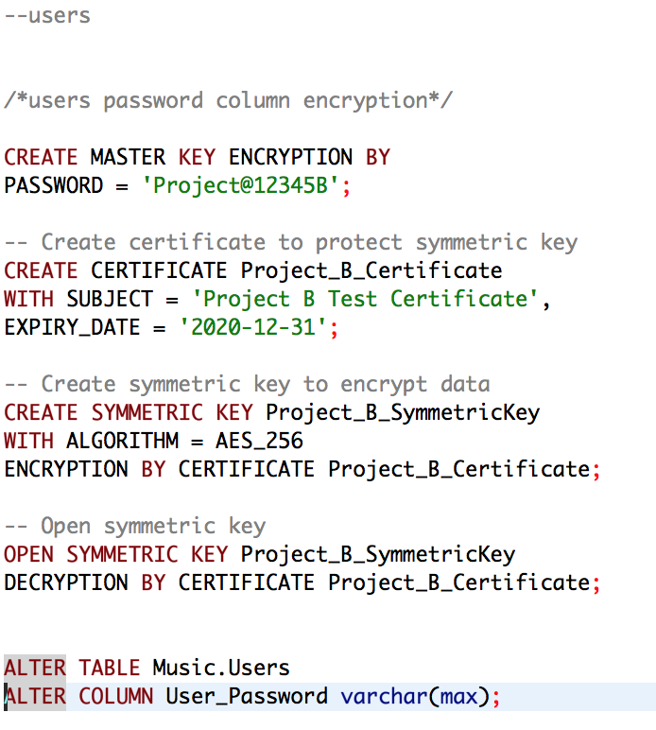
SQL DDL

Slide 9
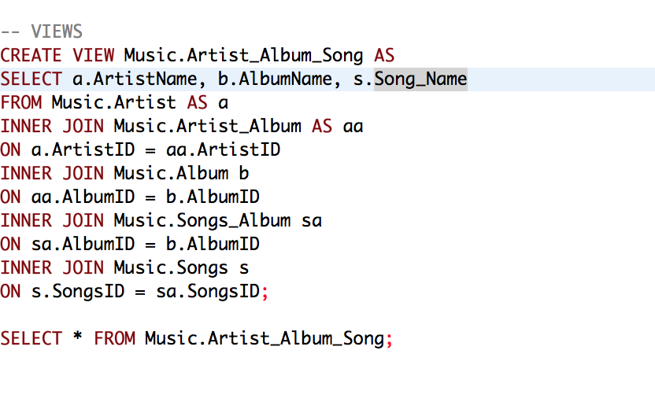
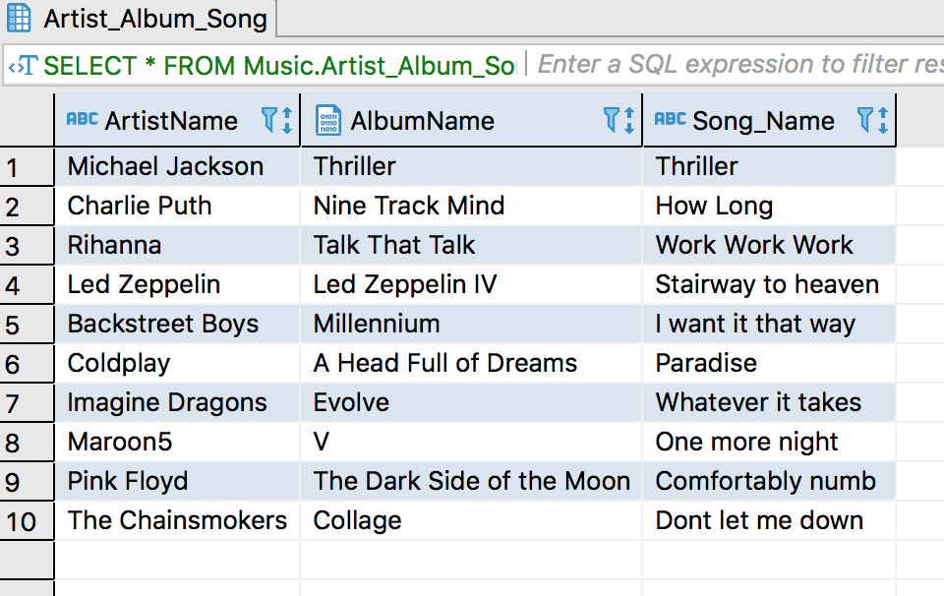
SQL VIEW

Slide 10
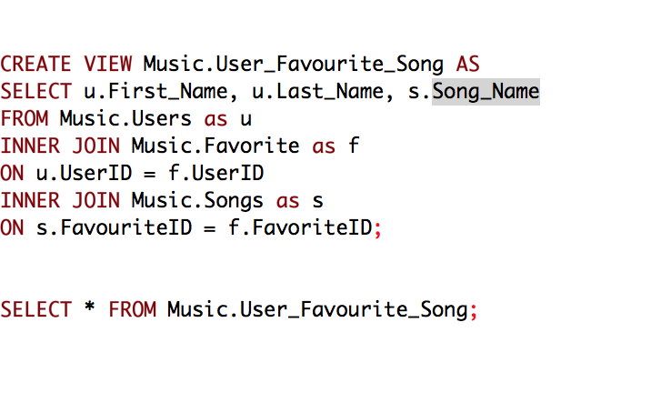
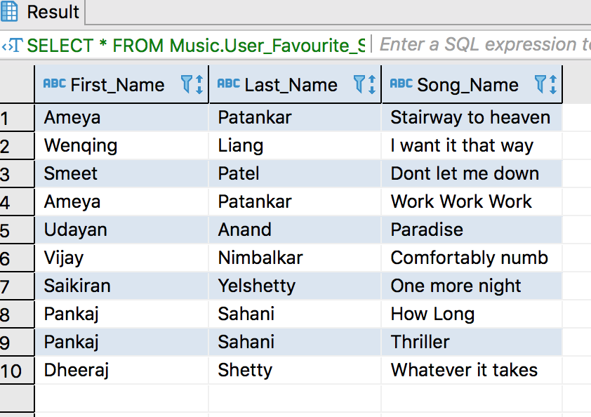
SQL VIEW

Slide 11
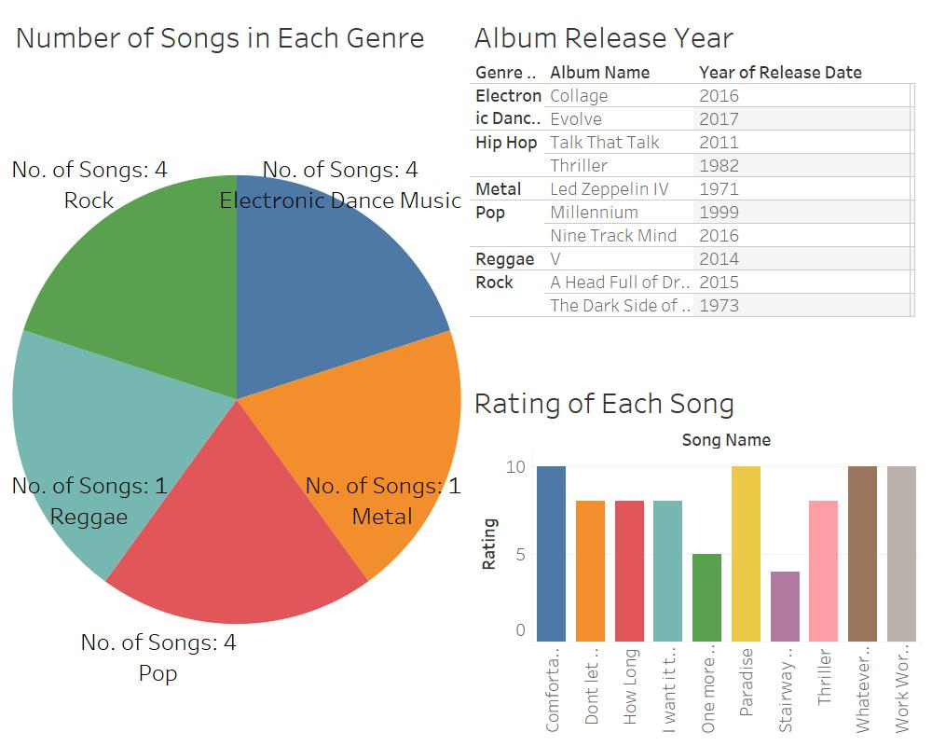
REPORT

Slide 12
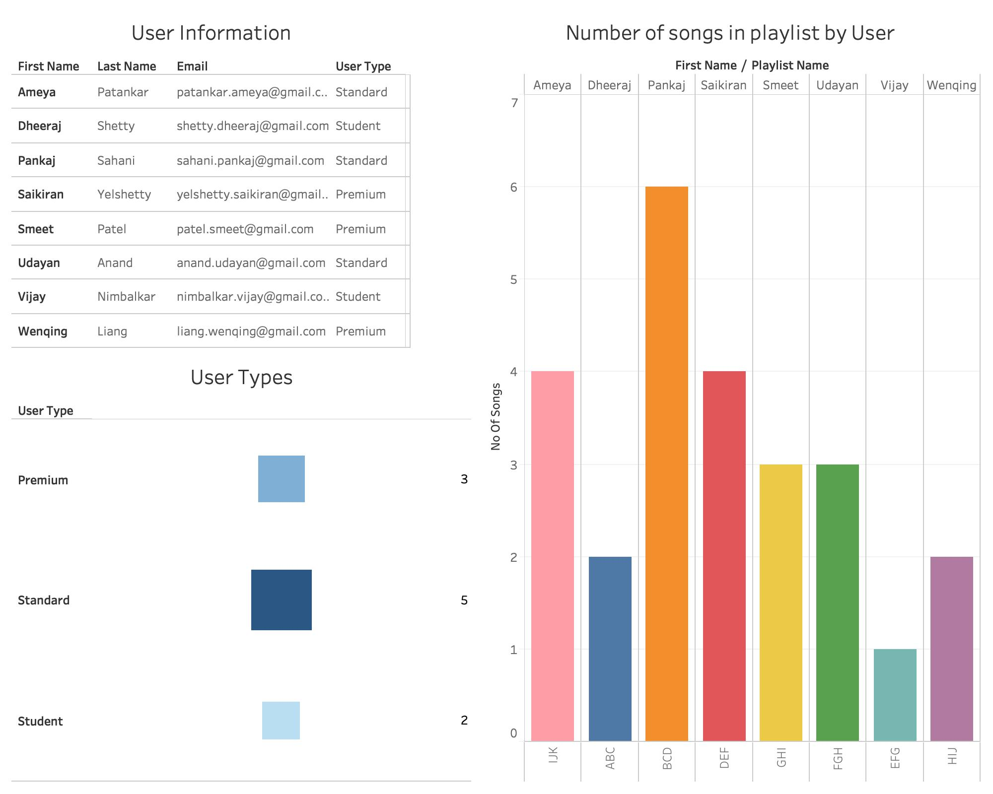
REPORT

